Slide 1
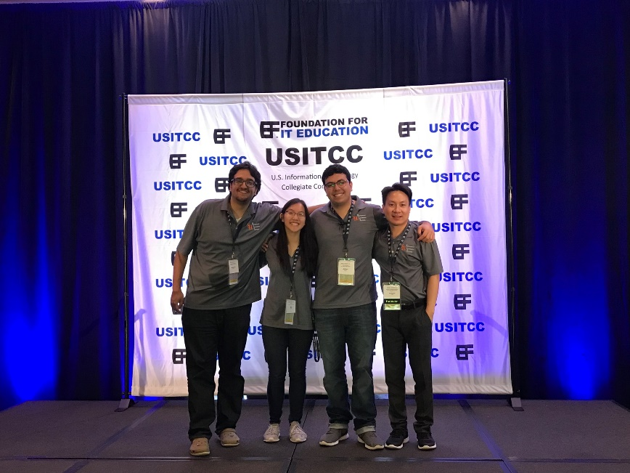
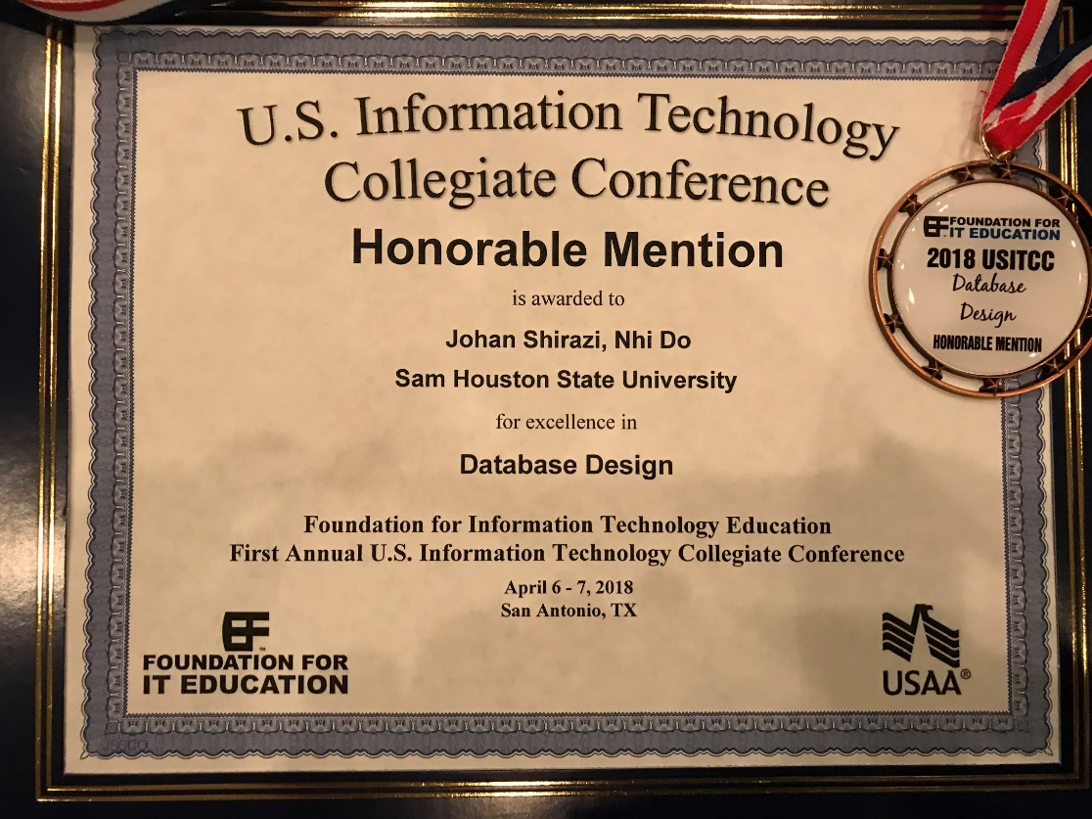
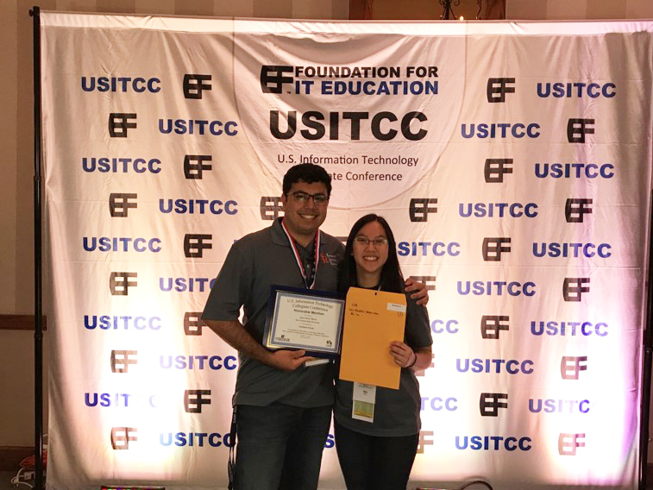
MIS students (Nhi Do, Johan Shirazi, and Mohammed Alsharif) competed at the USITCC Conference. Nhi and Johan won an Honorable Mention for Database Competition.
AITP Advisors: Dr. Wipawayangkool
Dr. Warner
Sponsors: COBA & Global Shop Solutions

